Slide 1

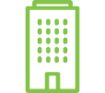
55%
49%
All
companies
B2B
companies
On average, 49% of companies are currently using marketing automation, with more than half of B2B companies (55%) adopting the technology.
Source:
“The Ultimate Marketing Automation stats” (2016)

Slide 2

67%
Best-in-Class companies are 67% more likely to use a marketing automation platform.
Source:
“State of Marketing Automation 2014: Processes that Produce” (2014)

Slide 3
2011
2016
B2B organizations using marketing automation
There are nearly 11 times more B2B organizations using marketing automation now than in 2011.
Source:
“B-to-B Marketing Automation Study” (2016)

Slide 4


Hyper-Personalized Conversations:
The Key to a Wider Marketing Funnel
Presented by:
Rick Carlson
CEO, SharpSpring

Slide 5
When my Dad bought a car in 1990…
Notes:
Who remembers buying a car in the 1990s? I can remember my Dad looking in the newspaper or on TV. Then, the trips to the dealerships started. Long trips, He went to multiple dealerships, spoke to a lot of sales people, drove a lot of cars, got the ‘best deal’ from a few places and made a decision.

Slide 6
When my wife bought a car last year...
Notes:
Went online, looked at reviews, looked at ratings from experts and industry publications, looked at features, colors and styles. Looked online at inventory. Emailed the dealerships to compare each other and finally went in. By the time we stepped foot on the lot, the deal was nearly done.

Slide 7
A Shift Happened
The Buyer’s Journey has Shifted from a Generic, Seller-Controlled Process to a
Buyer-Powered, Self-Guided Tour.

Slide 8
Quick Review of the Buyer’s Journey.
The Process of Discovery
From not knowing anything about you to buying your product or service
Crucial to understanding your buyer
Each stage requires a different type of conversation
Awareness
Consideration
Decision

Slide 9
For eons, the majority of the buyer’s journey was controlled by the seller.
85% of your effort WAS focused here
Journey on their own
Contact with person
Awareness
Consideration
Decision

Slide 10
By 2020, buyers will manage 85% of their own journey without talking to a human.
Gartner Customer 360 Summit
85% of your effort needs to be focused here
Journey on their own
Contact with person
Awareness
Consideration
Decision

Slide 11
What Were Buyer-Seller Interactions Like Before this Shift?
- Rich, personal, face-to-face conversations
- Seller qualified the buyer and tailored offers
- Buyer explored options and asked questions
- Both buyer and seller adapted to these exchanges
All in Real Time
85% of your effort WAS focused here
Journey on their own
Contact with person
Awareness
Consideration
Decision

Slide 12
What Have Buyer-Seller Interactions Been Like Lately?
Buyers wander in the dark, searching, sorting, and sifting, for static data points from a sea of information
Sellers too often scream at buyers from glorified digital billboards with generic content
Truly Interactive, engaging, two-way communications between buyers and sellers are few and far between
85% of your effort needs to be focused here
Journey on their own
Contact with person
Awareness
Consideration
Decision

Slide 13
But what if…
you could bring the best of previous era human conversations to your new era digital marketing?

Slide 14
How Would We Do That?
NOT WITH…
BUT WITH…
Static, one-way web sites
Adaptive web sites based on needs
Generic email blasts
Hyper-personalized relevant emails
Treating all leads equally
Qualifying leads based on behavior
Having the same conversation with all
Custom nurturing based on funnel stage
Notes:
Highly Relevant Content
Laser-Targeted Exchanges
Two-Way Conversations
Information Gathering by Both Buyer and Seller
Dynamic and Responsive Experiences
ALL IN REAL TIME

Slide 15
A Different Era Requires a New Approach
1950
1960
1970
1980
1990
2000
2010
2020
Beyond
Mass
Marketing
Segment Marketing
Relationship Marketing
Hyper-Personalized Conversations
AI/Predictive
Marketing
More meaningful, engaging and fulfilling, both for the buyer and seller.

Slide 16
Marketing Automation Enables All of This
By engaging a buyer as a unique individual in
ongoing, two-way, hyper-personalized conversations leveraging the following features…
Adaptive web sites
Behavioral based lead tracking
Web Visitor ID
Dynamic nurture campaigns
Dynamic list building
Lead scoring
Next gen emails
Shopping cart optimization
Campaign tracking
CRM integration
Dynamic landing pages
Social integration

Slide 17
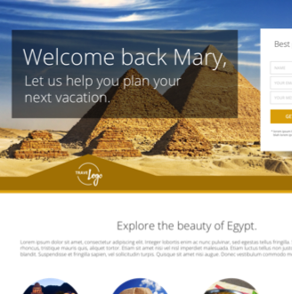
Personalized website content
219%
Source:
VentureBeat State of Marketing Technology
Boosts conversion rates by 219%.

Slide 18

Personalized vs. non-personalized mailings
29%
41%
29% higher unique open rates
41% higher unique click rates
Source:
Experian Marketing Services

Slide 19
Personalized vs. Generic Emails
</>
360%
Source:
360% higher conversions

Slide 20
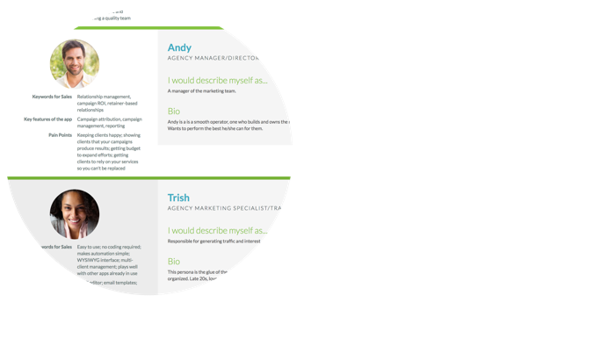
Companies that use Personas to segment their customers
93%
Source:
93% exceed lead and revenue goals

Slide 21
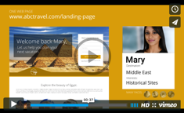
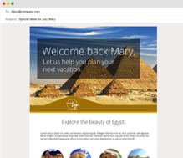
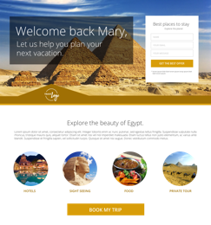

The Cumulative Effect?
Video Here
Hyper-Personalized Conversations Widen Your Sales Funnel
Email Marketing
Landing Pages
Website Visits
Product Recommendations
Customer Offers
Notes:
Slide notes: Companies that succeed will adapt by providing plentiful, hyper-personalized communications, experiences and resources to facilitate the buyer’s journey. Those who engage in two-way and hyper-personalized conversations will be best positioned to influence buyers’ decisions in the growing pre-contact phase.

Slide 22
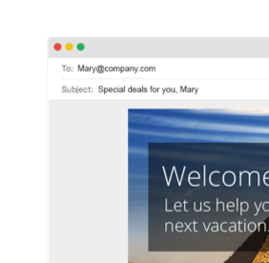
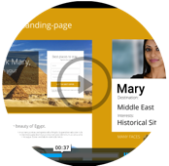


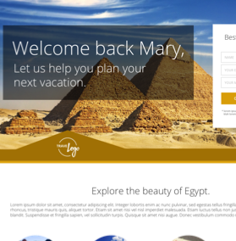
Hyper-personalized conversations:
Drive leads
Convert leads to opportunities
Turn opportunities into sales
Notes:
Slide notes: Companies that succeed will adapt by providing plentiful, hyper-personalized communications, experiences and resources to facilitate the buyer’s journey. Those who engage in two-way and hyper-personalized conversations will be best positioned to influence buyers’ decisions in the growing pre-contact phase.

Slide 23
How Exactly Does Marketing Automation Enable Hyper-Personalization?
… First, let’s review the results from a traditional marketing funnel.
Notes:
You’ve heard this before. Let’s see how MA really DOES it.

Slide 24
Traditional Marketing
Driving Leads
Every action people have to take requires a decision. At most decision points, more than 50% of your audience (usually more like 80-99%) opts out.
- Brian Carter Group, Internet Marketing Strategy - 5 Funnel Mistakes
Nurturing
Only 25% of leads are legitimate and should advance to sales.
- Gleanster Research, Measuring the impact of lead nurturing on the sales pipeline.
Closing

Slide 25
How Does Marketing Automation Make This Funnel Wider?
Marketing Automation is a suite of tools that enables hyper-personalization
through rich, two-way conversations where questions and answers
are exchanged between buyers and sellers in real-time.
Let’s Explore.
Notes:
You’ve heard this before. Let’s see how MA really DOES it.

Slide 26




DRIVING
Traditional Marketing
Driving Leads
Visitor ID
Next Gen
Emails
Blog & RSS Email
Next Generation Email Campaigns
Campaign Tracking
Google AdWords
Reporting Analytics
Dynamic Landing Pages
Google AdWords Integration
Nurturing
Blogging and RSS
Email Integration
Closing
Campaign Tracking
Dynamic Landing Pages
& Forms
VisitorID (Anonymous
Site Visitor Identification)
Reporting/Analytics
Notes:
These are the features of MA that drive leads into your funnel. Let’s take a closer look at a few that exemplify personalized marketing.

Slide 27
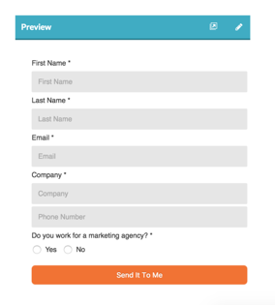
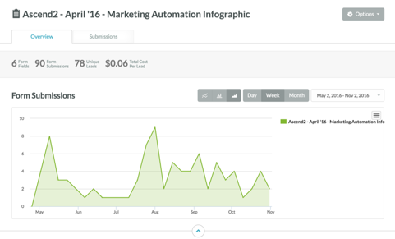
Dynamic Forms

Slide 28
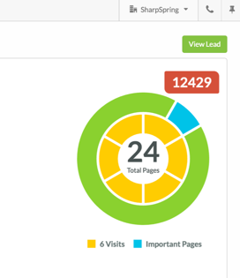
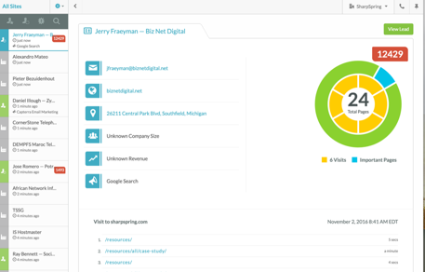
VisitorID
(Anonymous Site Visitor Tracking)

Slide 29
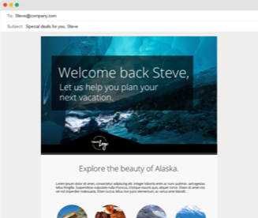
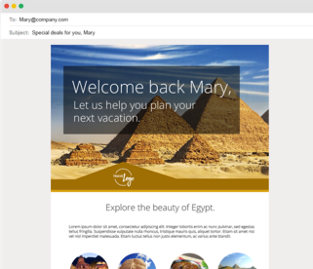
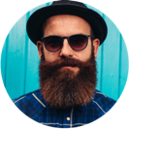

Dynamic Emails

Slide 30
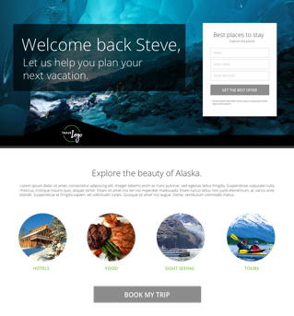

Dynamic Landing Pages

Slide 31
NURTURING
Traditional Marketing
Driving Leads
Behavioral Based Lead Tracking (Life of the Lead)
Visitor ID
Next Gen
Emails
Blog & RSS Email
Campaign Tracking
Google AdWords
Dynamic Landing Pages
Dynamic List Building
/Segmentation
Reporting Analytics
Nurturing
Behavioral Based Lead Tracking
Dynamic, Drip Campaigns
Personas
Lead Scoring
Lead Scoring
Dynamic List Building
Closing
Dynamic, Behavior-Based Email Drip Campaigns for Nurturing
Personas
Notes:
These are the features of MA that help nurture leads. Again, let’s look specifically at those that exemplify personalization.

Slide 32
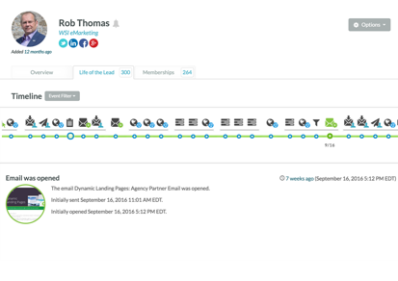
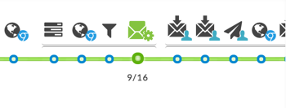
Behavioral Based Lead Tracking (Life of the Lead)

Slide 33
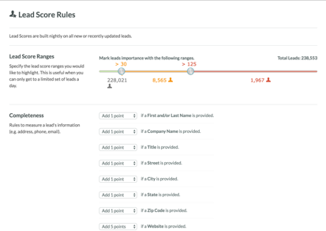
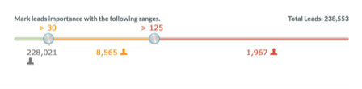
Lead Scoring

Slide 34
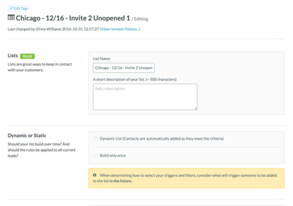
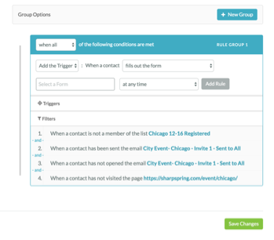
Dynamic List Building

Slide 35
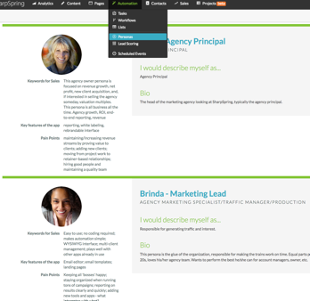
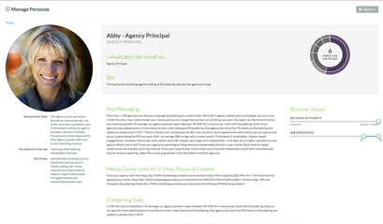
Personas

Slide 36
CLOSING
Traditional Marketing
Driving Leads
CRM/CRM Integration - B2B
Visitor ID
Next Gen
Emails
Blog & RSS Email
Campaign Tracking
Google AdWords
Lead Scoring
Reporting Analytics
Dynamic Landing Pages
Nurturing
Social Integration (Life of the Lead)
Behavioral Based Lead Tracking
Dynamic, Drip Campaigns
Lead Scoring
Dynamic List Building
Sales Management/Notification
Closing
Shopping Cart
Smart Emails and
Trackable Media
Social Integration
Sales Management
CRM/CRM Integration
Sales Email Automations
for Post-contact Nurturing
ROI Analytics
& Reporting
Lead Scoring
Smart Email
End-to-end ROI/Reporting
and Analytics
Shopping Cart Integration
/Abandonment - B2C
Notes:
These are the features of MA that help with closing leads. Let’s take a closer look at those that exemplify pesonalization.

Slide 37
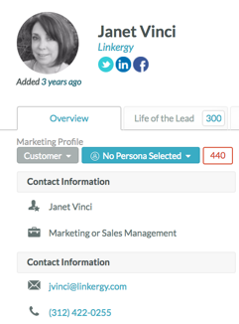
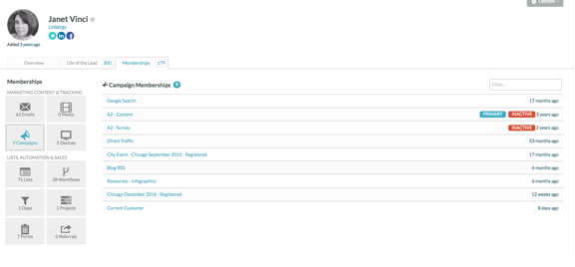
Contact Insights

Slide 38
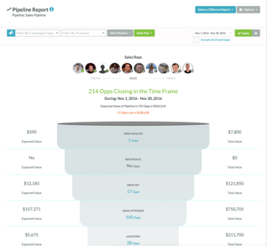
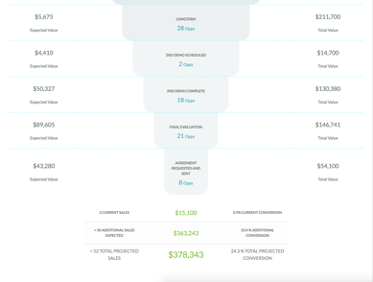
Sales Pipeline

Slide 39
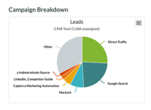
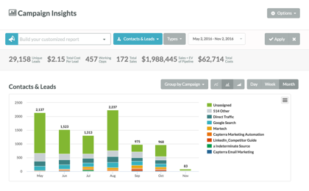
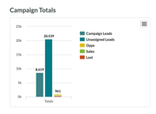
Campaign Insights

Slide 40
Marketing Automation
Traditional Marketing
Driving Leads
Visitor ID
Next Gen
Emails
Blog & RSS Email
Marketing Automation
+
Hyper-Personalization
=
Wider Funnel
Campaign Tracking
Google AdWords
Reporting Analytics
Dynamic Landing Pages
Nurturing
Behavioral Based Lead Tracking
Dynamic, Drip Campaigns
Lead Scoring
Dynamic List Building
Closing
Shopping Cart
Social Integration
Sales Management
CRM/CRM Integration
ROI Analytics
& Reporting
Lead Scoring
Smart Email
Notes:
Again, we’ve only reviewed SOME of the features to demonstrate how MA grows your funnel. There are lots more. Use marketing automation to re-engage those who fall out at any phase.

Slide 41
Marketing automation allows you to tailor the first 85% of the buyer’s journey with hyper-personalized conversations.
85% of your effort needs to be focused here
Journey on their own
Contact with person
Awareness
Consideration
Decision
Notes:
More dramtic, add dates, difference between before and after.

Slide 42
A challenge:
If you’re not already doing it, when you get back to your office, identify 3 ways your conversations with buyers can be more engaging, meaningful, two-way, and hyper-personalized.

Slide 43
Thank You
Drop by our booth to meet the team.
Visit www.sharpspring.com/izeafest for a special offer for IZEAFest attendees.

Slide 44


